Slide 1
Batuan’s Karst Landscapes
TOURISM OFFICE OF BATUAN, BOHOL
THE GEOLOGIC STORY OF BATUAN’S Caves, sinkholes, springs and interesting limestone formations like the Chocolate Hills

Slide 2
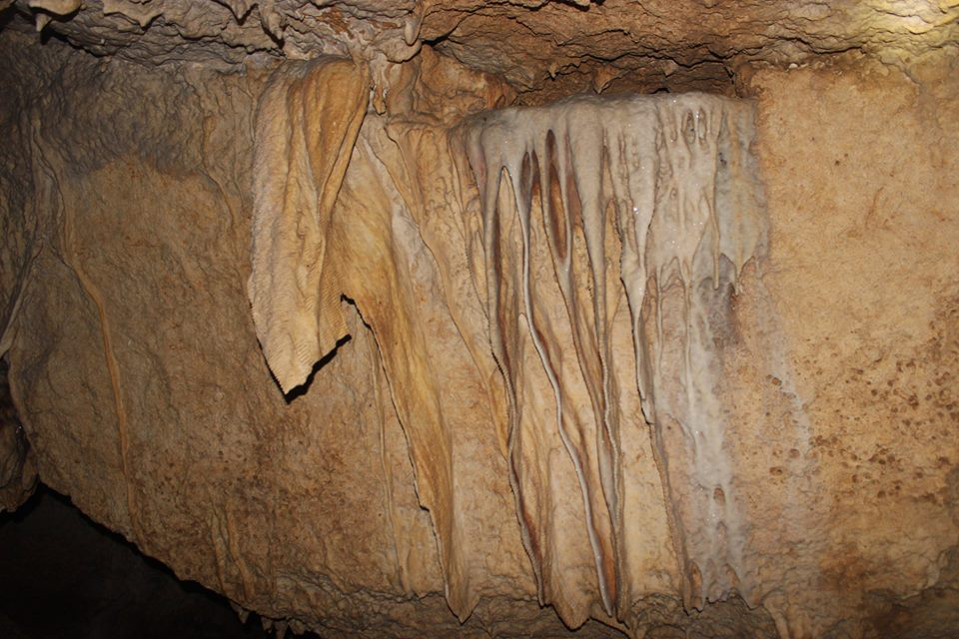
What is a karst landscape?
A karst landscape starts with soluble rock like limestone or dolomite that is then slowly dissolved by rainwater over thousands of years.
In Batuan, the limestone is 3 to 4 million years old and a formation hundreds of meters thick was uplifted as a result of tectonic plate movement.
As the limestone has dissolved, caves, sinkholes and springs have formed. Even the Chocolate Hills!

Slide 3
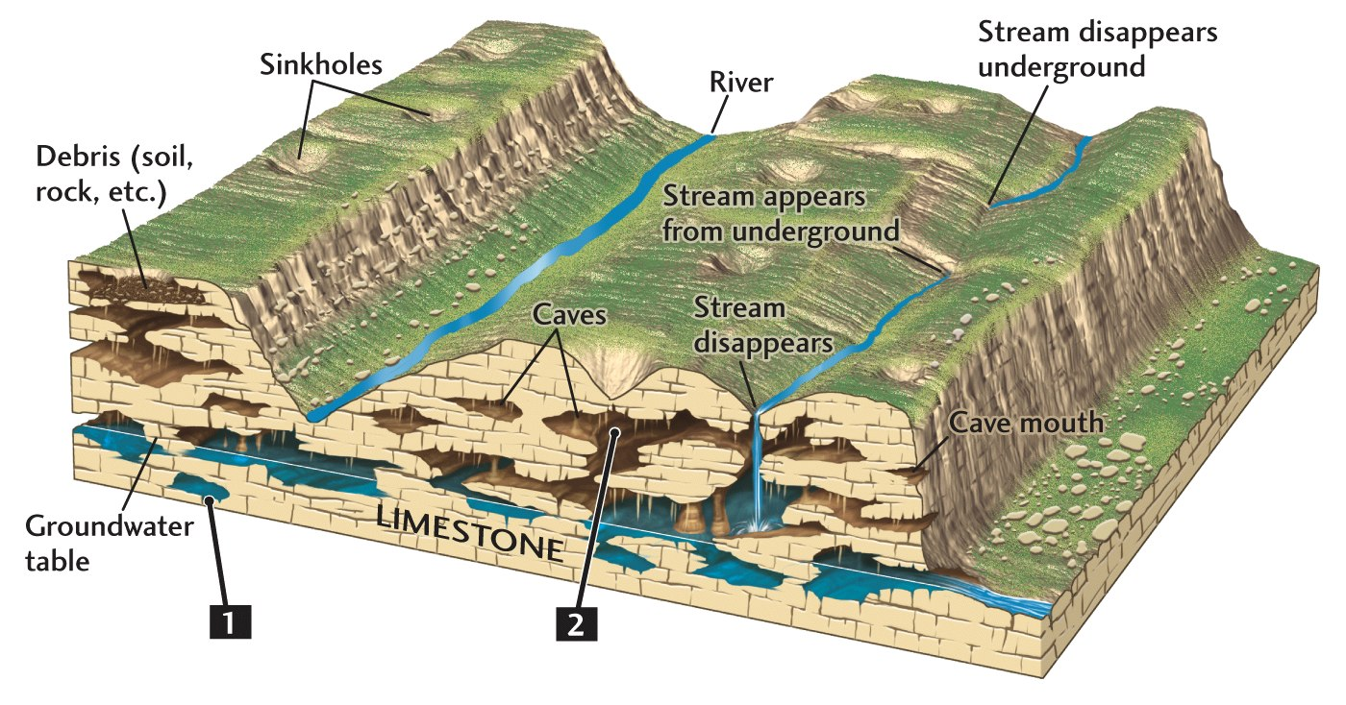
Cutaway of Karst Landscape

Slide 4
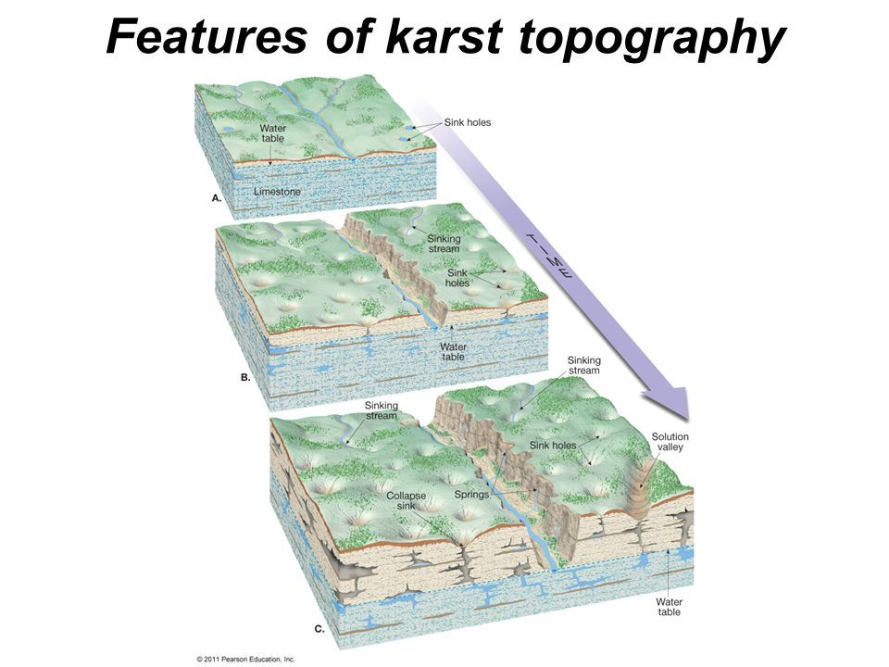
Water changes the limestone landscape over time.

Slide 5
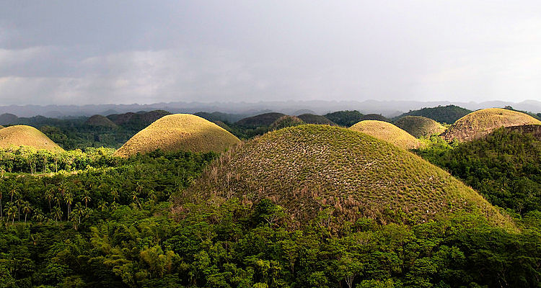
Chocolate Hills-Cone karst formations
For years geologists have wondered how the Chocolate Hills were formed. They now believe that the uplifted limestone was level and that the softer portions dissolved leaving the cone karst formations that we know as the Chocolate Hills.
Try our Close Encounter with the Chocolate Hills Tour

Slide 6

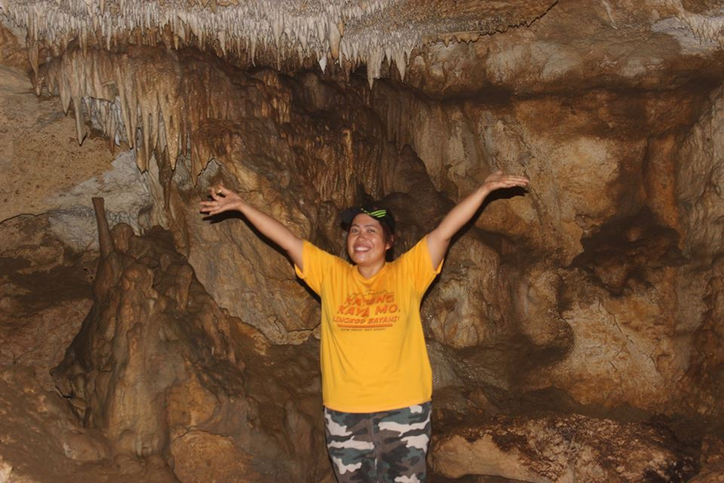
The Caves of Batuan
No one knows how many caves there are in Batuan, but it’s safe to say that the hills are full of them!
You can see stalactites, stalagmites and other interesting formations like frozen waterfalls.
Try our Janlud Cave Tour or our Rizal Package Tour

Slide 7
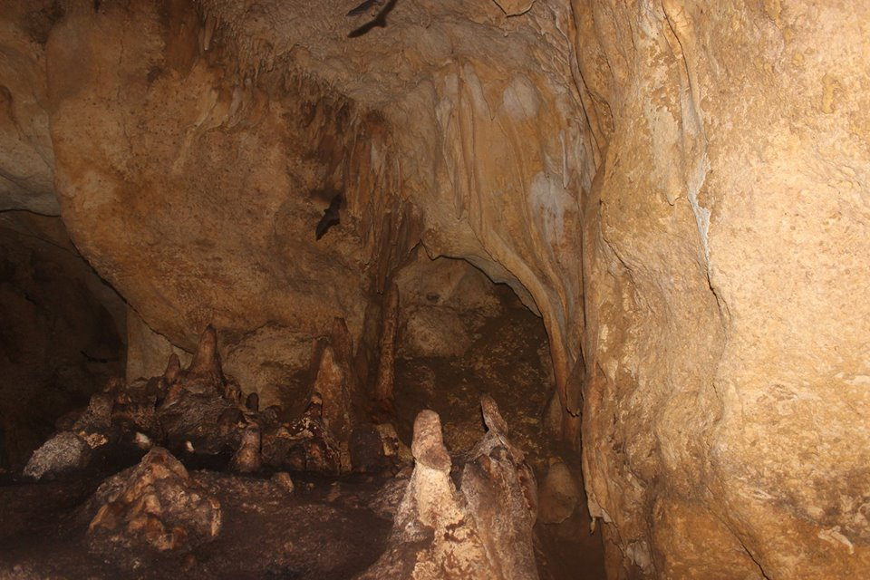
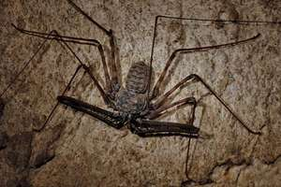
Cave Creatures
Every large cave in has bats, nine different species have been found in Batuan’s caves. You may also find the Tailless Whip Scorpion or small albino crustaceans.

Slide 8
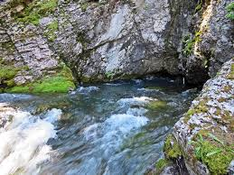
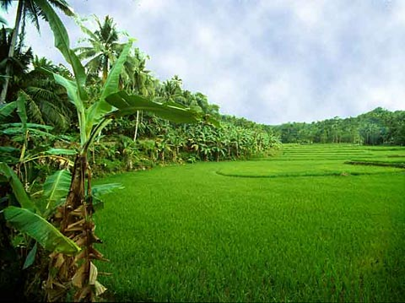
How are Batuan’s karst springs and rice fields related to each other?

Slide 9
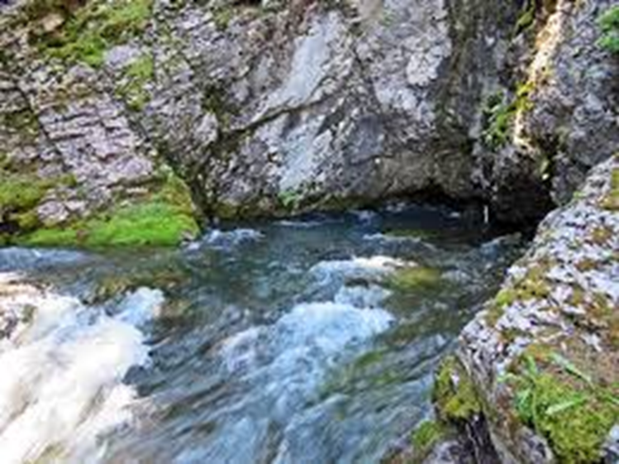
The karst landscape of Batuan is essential for rice farming
The numerous springs in Batuan are often found at the base of the hills and mountains.
Over the years, this water has been diverted to the rice fields so that they can be flooded and irrigated.

Slide 10

The whole rice field flows with spring water!
Instead of the rivers and streams of a traditional surface drainage system, the rainwater in Batuan flows into the mountains and out through the springs.
It is then directed to the rice fields so that water flows slowly throughout the entire valley towards the sea.

Slide 11
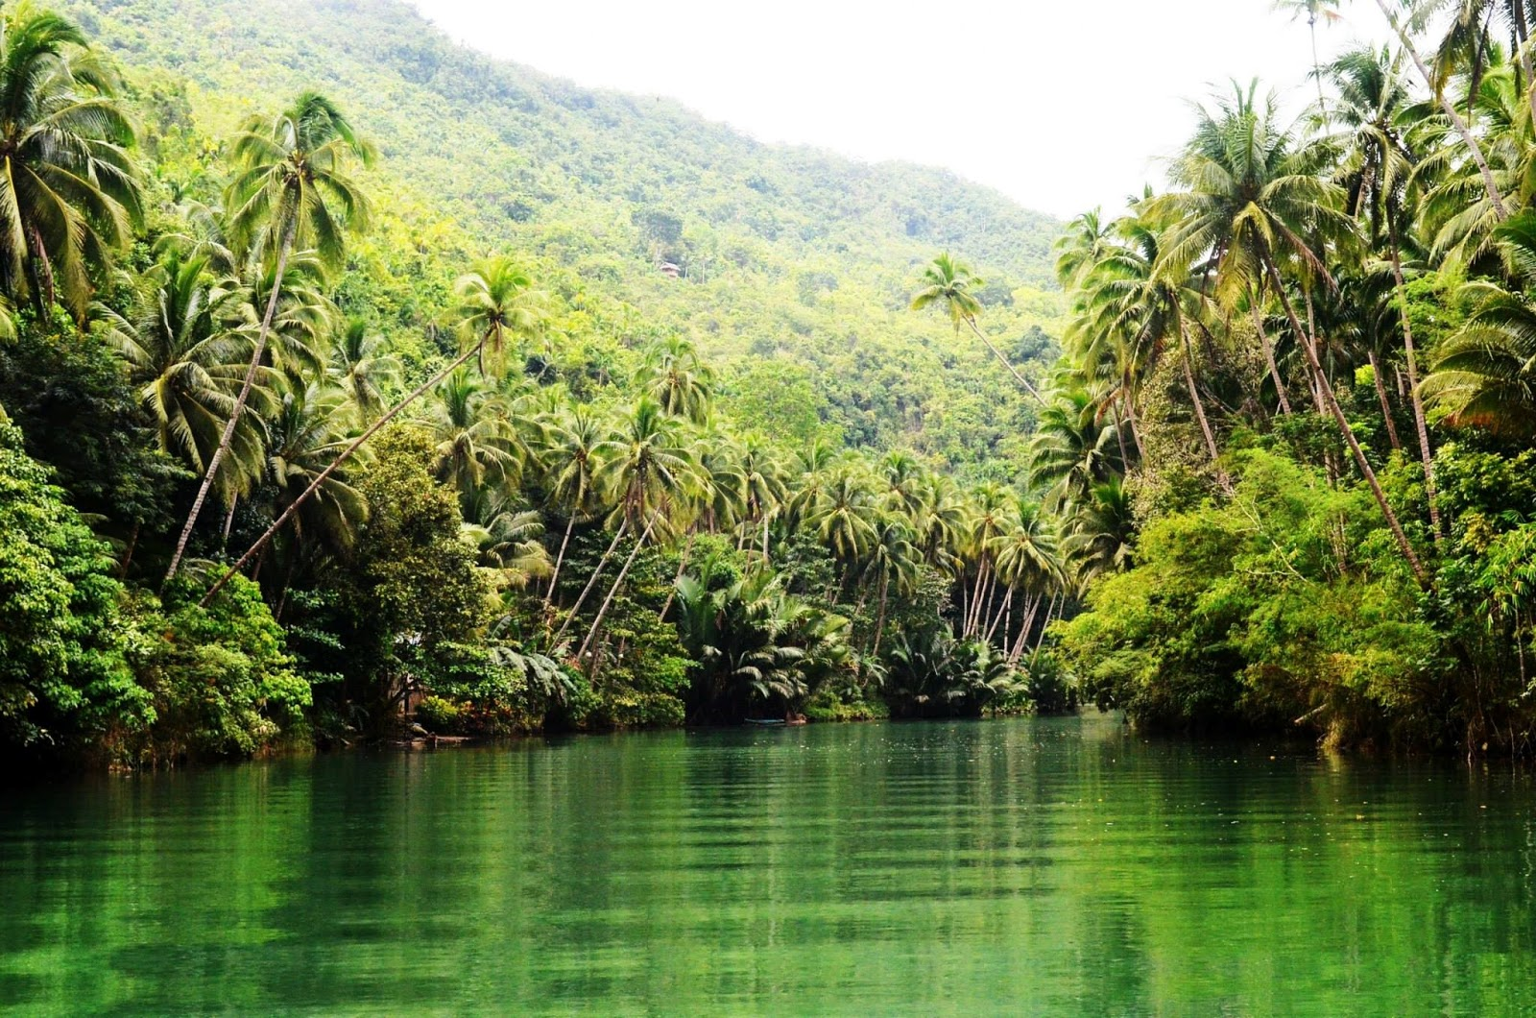
Why is the Loboc River green?
Calcium carbonate is dissolved by rainwater as it flows through the limestone giving the water its distinctive color. The Loboc River gets its stunning emerald color because the water flowed through the hills of Batuan, Carmen and other upland municipalities.

Slide 12
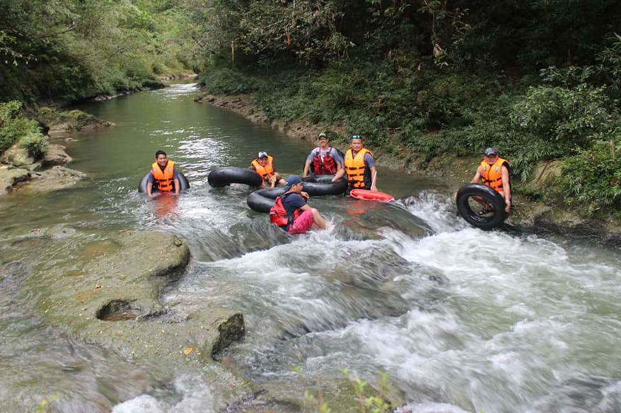
The Loboc River is called the Makapiko in Batuan
The color of the Makapiko is a muted version of the Loboc’s emerald. The color intensifies as the water moves downstream.
Try our Makapiko River Tubing Tour or our Rizal Tour

Slide 13
BATUAN TOURISM OFFICE
UNDISCOVERED ADVENTURE TOURS
RIZAL PACKAGE TOUR – HIKING, CAVING AND TUBING THE MAKAPIKO RIVER
JANLUD CAVE TOUR – CAVING IN JANLUD
CLOSE ENCOUNTER WITH THE CHOCOLATE HILLS – A HIKE TO THE TOP OF A CHOCOLATE HILL
TUBING TOUR – TUBING ON THE MAKAPIKO RIVER
FARM TOUR – A TOUR OF JOLIT’S GARDEN IN CAMBACAY

